Slide 1

ER Diagram
Team 2

Slide 2
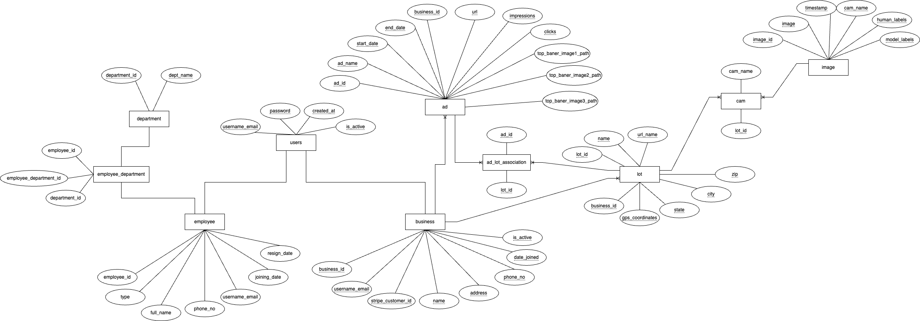
Conceptual diagram

Slide 3
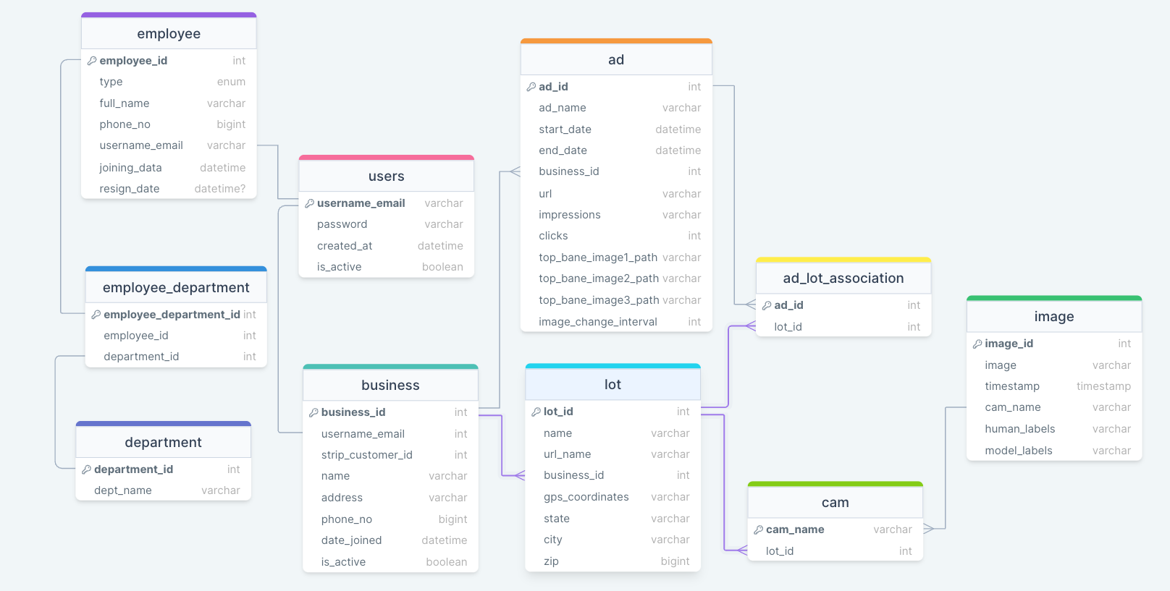
Logical diagram

